Slide 1
Introduction
Name : Madhusudan
College : Gurugram University
Branch : Computer Science and Engineering (CSE)
LinkedIn Profile : www.linkedin.com/in/madhusudan2004
GitHub Profile : https://github.com/Maddhusudan/YesBank_stock_Prediction
Project Title : Predicting Stock Price of Yes Bank of India

Slide 2
Problem Statement (Simple Version)
Yes Bank's stock prices changed a lot, especially after a fraud case in 2018. This project aims to study those changes and use past data (like opening, high, and low prices) to predict the closing price of the stock each month.
We will try different machine learning models to see which one gives the best and most accurate predictions.

Slide 3
Dataset Overview
Source: Monthly stock prices of Yes Bank
Total Records: Data from 2005 to recent years
Columns Available:
Date – Month and year
Open – Price at the beginning of the month
High – Highest price during the month
Low – Lowest price during the month
Close – Price at the end of the month (target)
Extra Features Created:(Feature Engineering)
Month and Year from the Date column

Slide 4
Target Variable Selection
The Close price column was selected as the target variable for prediction. This column represents the final stock price at the end of each trading day, making it the most relevant metric for stock price prediction models.

Slide 5
Technologies and Models Used
Technologies & Libraries:
pandas – for reading and manipulating data
matplotlib – for data visualization
scikit-learn – for model training and evaluation
xgboost – for boosting-based model
numpy – for numerical operations
Machine Learning Models Used:
Linear Regression
Random Forest Regressor
XGBoost Regressor

Slide 6
Hyperparameter Tuning
Model | Hyperparameter Tuning | Effect of Tuning
Linear Regression | Not Applicable | No hyperparameters to tune — performance is fixed.
Random Forest | Applicable | No improvement seen — MAE & R² remained the same.
XGBoost | Applicable | Improvement in MSE and R² — tuning gave better results.
Model | Hyperparameter Tuning | Effect of Tuning
Linear Regression | ❌ Not Applicable | No hyperparameters to tune — performance is fixed.
Random Forest | ✅ Applicable | No improvement seen — MAE & R² remained the same.
XGBoost | ✅ Applicable | Improvement in MSE and R² — tuning gave better results.
Insights
Hyperparameter tuning is most effective on XGBoost, improving R² from 0.9753 → 0.9802.
No effect on Random Forest, indicating default parameters were already near-optimal.
Linear Regression has no tunable parameters — it's a simple, interpretable model.

Slide 7
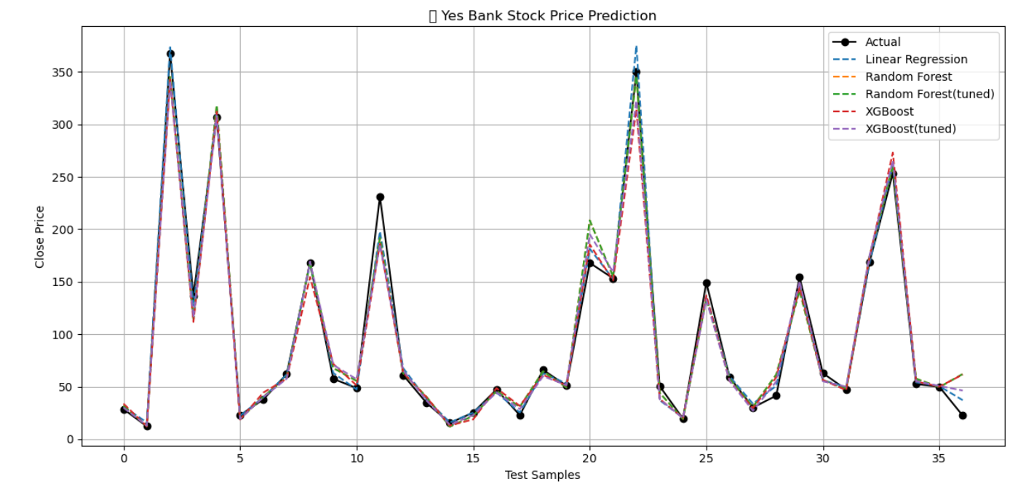
Graphical Visualization

Slide 8
Conclusion
The project successfully predicted Yes Bank's stock closing prices using historical data
and various machine learning models.
2. Among all models tested, Linear Regression performed best, achieving the highest accuracy
and lowest error, making it the most suitable for this dataset.
Hyperparameter tuning improved the performance of XGBoost, while
Random Forest showed no significant benefit from tuning. Linear Regression
does not support tuning due to its simplicity.

Slide 9
THANK YOU

